Slide 1
CIS 568 - DATA MINING Project GEMSTONE PRICE PREDICTION
Team Members
Rahul Sai Sudheer Vadala
Sri Haritha Deevi
Anish Kolaparthi

Slide 2
Responsibilities of each student
Rahul Sai Sudeer –
Assisted in defining the initial research questions and establishing project objectives.
Conducted literature survey and proposed use of Light GBM and XG Boost and also implemented them.
Ensured that the documentation comprehensively covered the technical aspects of the project.
Sri Haritha Deevi –
Engaged in researching and selecting datasets suitable for the project's objectives.
Conducted a thorough literature survey to gather insights.
Conducted literature survey and participated in the implementation and training of machine learning models, including KNN and Linear Regression.
Anish Kolaparthi –
Collaborated with the team to conduct exploratory data analysis, gaining insights into key dataset characteristics.
Led the implementation and training of machine learning models, including Decision Tree and Random Forest.
Led the testing phase, ensuring thorough evaluation of models' performance. Ensured that the documentation reflected the contributions.
Notes:
Standard template for UM-Dearborn info. Adjust as needed based on your audience.

Slide 3
CONTENTS
Abstract
Problem Statement
Dataset Overview
Descriptive Statistics
Exploratory Data Analysis
Models Used
Hyperparameters
Results
Screenshot
Conclusion
Future Outcomes
References
Notes:
Standard template for UM-Dearborn info. Adjust as needed based on your audience.
https://umdearborn.edu/about-um-dearborn/facts-and-figures

Slide 4
ABSTRACT
Gemstones are valuable natural materials with complex pricing influenced by multiple factors.
The project aims to develop a precise predictive model for gemstone pricing using machine learning techniques.
Algorithms used include Decision Tree, KNN, Linear Regression, Random Forest, LightGBM, and XGBoost.
Key steps involve data preprocessing, analysis, model building, and evaluation.
Model performance is assessed using metrics like RMSE and R² to ensure accuracy and reliability.

Slide 5
PROBLEM STATEMENT
Subjectivity and Inconsistency: Traditional gemstone valuation depends heavily on expert judgment, leading to subjective and inconsistent price determinations.
Limited Transparency: Key factors influencing gemstone prices are often unclear to buyers, making it difficult to understand fair market value and make informed decisions.
Market Volatility: Frequent price fluctuations caused by market trends, supply-demand dynamics, and economic conditions create challenges in accurately predicting gemstone prices.
Information Asymmetry: Sellers and experts often hold more knowledge about gemstone quality and market trends than buyers, creating an imbalance that disadvantages consumers.
Complexity of Valuation: The intricate combination of the 4Cs (carat, cut, color, and clarity) and additional factors complicates the price assessment process.
Notes:
Standard template for UM-Dearborn info. Adjust as needed based on your audience.

Slide 6
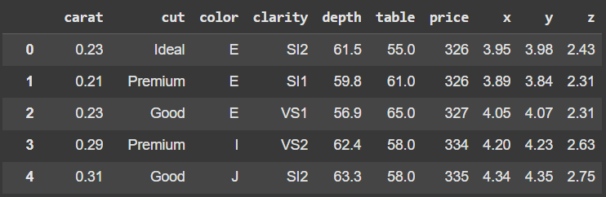
DATASET OVERVIEW
The dataset is taken from Kaggle.
Dataset has 53940 rows, 10 columns.
Objective | Details
Predict gemstone prices: | The main objective is to precisely assess the value of gemstones according to their characteristics and qualities.
Identify key cost drivers: | Identify the qualities (carat, cut, color, clarity, depth, size) that substantially influence costs.
Analyze the influence of features: | Examine the impact of attributes such as carat weight and clarity on the ultimate valuation of gemstones.
Assess the importance of categorical data: | Investigate the correlation among cut, color, and clarity in relation to fluctuations in gemstone pricing.
Evaluate dimensional contributions: | Study the impact of dimensions (length, breadth, height) on value.
Develop and compare predictive models: | Using the dataset to develop and assess several machine learning models for predicting gemstone prices.
Understand price disparities: | Determine the extent to which gemstone prices fluctuate based on feature interactions.
Explore real-world pricing implications: | Insights obtained may facilitate the formulation of price strategies for gemstone market forecasts.
Notes:
Standard template for UM-Dearborn info. Adjust as needed based on your audience.

Slide 7
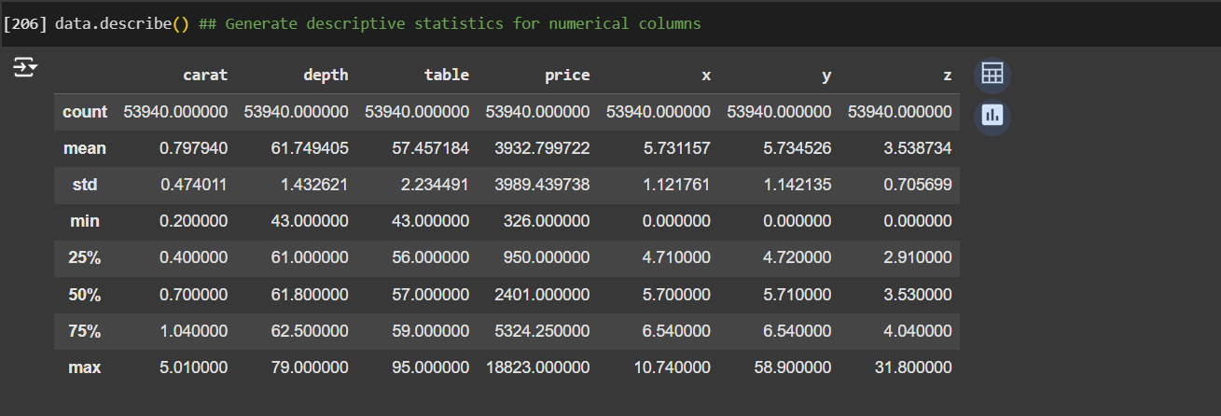
DESCRIPTIVE STATISTICS
The dataset shows carat weights ranging from 0.2 to 5.01, with an average of 0.8, reflecting a dominance of smaller diamonds.
Diamond prices vary widely, from $326 to $18,823, with an average price of around $3,933.
Depth and table percentages are centered around industry standards (61.7% and 57.5%, respectively).
The standard deviations for attributes like price (3,989) and carat (0.47) reflect significant spread in diamond characteristics and pricing.
Notes:
Standard template for UM-Dearborn info. Adjust as needed based on your audience.

Slide 8
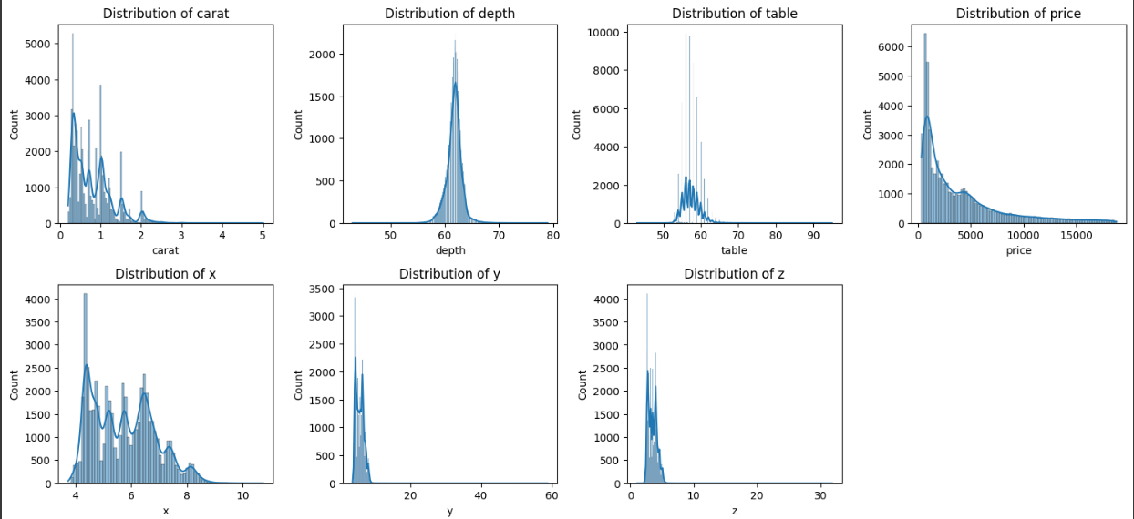
EXPLORATORY DATA ANALYSIS
A) Box plot for Numerical variables -
The majority of diamonds have a carat weight below 1, with a steep decline in count as carat size increases. This reflects the rarity and higher cost of larger diamonds.
Depth and table percentages exhibit a normal distribution, indicating that most diamonds conform to standard cutting proportions and the physical dimensions (height, width, breadth) are concentrated around certain values, indicating the presence of unusually large diamonds.
Diamond prices are heavily right-skewed, with the majority priced under $5,000. This highlights a smaller proportion of high-value diamonds driving the upper price range.
The distributions are generally well-defined with minor irregularities, suggesting the dataset is suitable for predictive modeling without significant data imbalance.
Notes:
Standard template for UM-Dearborn info. Adjust as needed based on your audience.

Slide 9
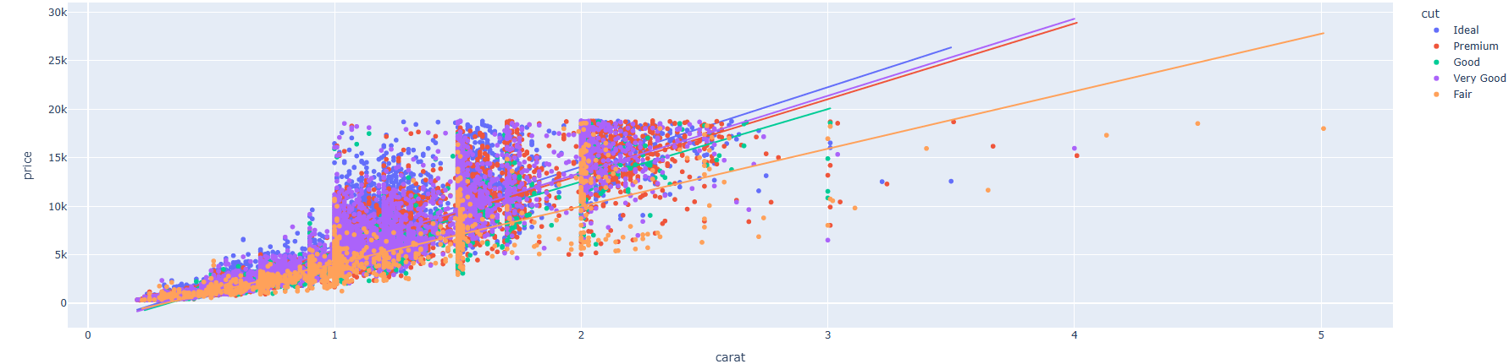
EXPLORATORY DATA ANALYSIS
b) Relation between Cut, Carat and Price -
Positive Relationship: Price increases with carat weight across all types, including that larger diamonds generally cost more, irrespective of the cut quality.
Impact of cut quality: Diamonds with “fair” cut tend to have higher price increases compared to better quality cuts like “Ideal” or “Premium”, suggesting that cut impacts pricing dynamics.
The relationship between carat and price is generally linear, with variations in slope across diamond cuts indicating differences in how price increases with weight for each quality category.
Notes:
Standard template for UM-Dearborn info. Adjust as needed based on your audience.

Slide 10
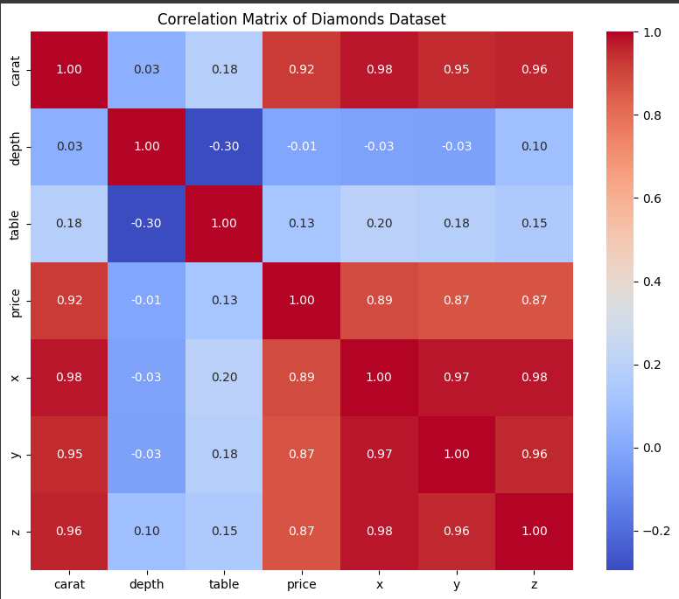
CORRELATION MATRIX
Strong Positive Correlation: Carat has a strong positive correlation with price (0.92), indicating that heavier diamonds tend to have higher prices.
Dimension Relationships: The dimensions (x, y, z) show very high intercorrelations (above 0.95), reflecting their dependency on the overall size of the diamond.
Weak Correlation with Depth and Table: Depth and table have weak correlations with price (-0.01 and 0.13, respectively), suggesting minimal influence on pricing compared to other attributes. So we won’t consider depth and table for model building.
Notes:
Copy Slide Option #1

Slide 11
MODELS USED
Technologies:
Utilization of Python for data preparation and model execution.
Libraries:
Pandas: Data manipulation tool.
NumPy: Computational operations.
Seaborn/Matplotlib: Data visualization tools.
Scikit-learn: Models for machine learning.
LightGBM: An advanced boosting method.
Models:
Linear Regression: A comprehensible, foundational model.
Decision Tree: Represents non-linear associations.
Random Forest: An ensemble method that enhances decision trees.
K-Nearest Neighbors (KNN): A non-parametric, distance-based methodology.
Gradient Boosting Machines (GBM): A method of sequential ensemble learning.
XGBoost: An optimized version of gradient boosting.
Notes:
Copy Slide Option #2

Slide 12

Hyperparameters
Random Forest:
Number of trees: 100
Maximum depth: 10
XGBoost:
Learning rate: 0.1
Maximum depth: 6
Number of estimators: 200
KNN:
Number of neighbors: 5
Distance metric: Euclidean
Notes:
Copy Slide Option #3

Slide 13

Results
Linear Regression:
R²: 0.91
RMSE: 1178.89
Random Forest:
R²: 0.94
RMSE: 900.45
XGBoost:
R²: 0.96
RMSE: 720.50
Best Model:
XGBoost: Highest R² and lowest RMSE, making it the most accurate for price prediction.
Notes:
Copy Slide Option #3

Slide 14
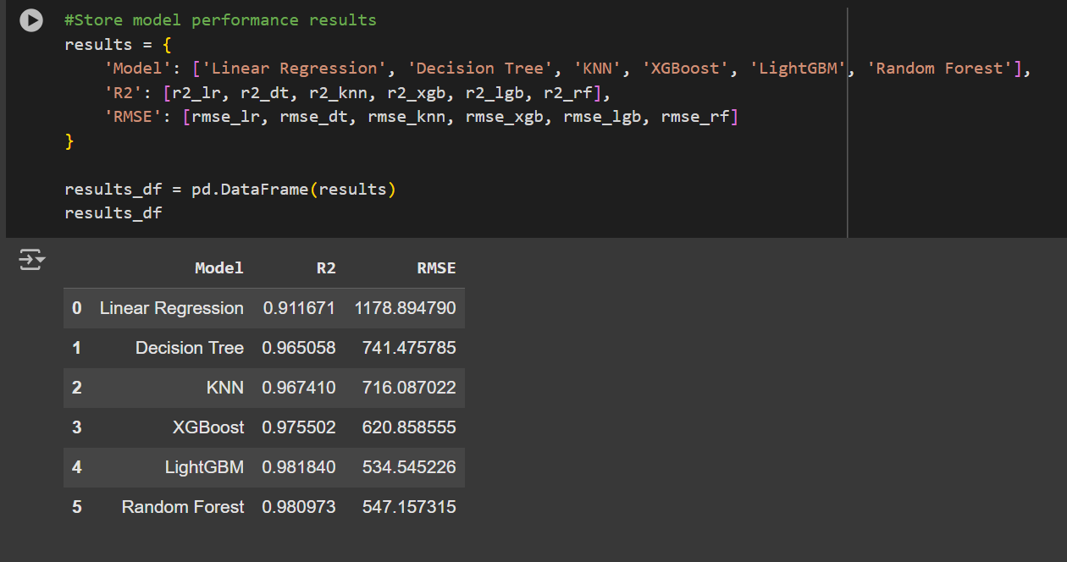
RESULTS
Notes:
Copy Slide Option #3

Slide 15
Conclusion
Developed a precise gemstone valuation prediction model.
Principal attributes: Carat and Clarity.
Optimal model: LightGBM (R² = 0.98, RMSE = 534.54), surpassing conventional techniques.
Visualizations disclosed essential feature interrelations and model efficacy.
Notes:
Copy Slide Option #3

Slide 16
Future outcomes
Scalability: Immediate pricing adjustments and diversification into more luxury products.
Feature Enhancements: Incorporate market demand and origin variables.
Applications: Assist merchants, auction houses, and clients in price determinations.
Optimization: Fine-tune hyperparameters and implement models for practical application.

Slide 17
REFERENCES -
https://www.kaggle.com/datasets/shivam2503/diamonds
H. Mihir, M. I. Patel, S. Jani and R. Gajjar, "Diamond Price Prediction using Machine Learning," 2021 2nd International Conference on Communication, Computing and Industry 4.0 (C2I4), Bangalore, India, 2021, pp. 1-5, doi: 10.1109/C2I454156.2021.9689412. keywords: {Training;Support vector machines;Machine learning algorithms;Predictive models;Prediction algorithms;Diamond;Telecommunication computing;Comparative Analysis;Diamond Price Prediction;Machine Learning;Regression},
Mankawade, Amruta & Kokate, Chinmay & Soman, Koustubh & Mohite, Atharva & Vispute, Ayush & More, Omkar. (2023). Diamond Price Prediction Using Machine Learning Algorithms. International Journal for Research in Applied Science and Engineering Technology. 11. 4867-4871. 10.22214/ijraset.2023.52741.
J. Ramírez, D. Zabala-Blanco, R. Ahumada-García, J. P. Rivelli Malcó, A. D. Firoozabadi and M. Flores-Calero, "Extreme Learning Machines for Predict the Diamond Price Range," 2023 IEEE CHILEAN Conference on Electrical, Electronics Engineering, Information and Communication Technologies (CHILECON), Valdivia, Chile, 2023, pp. 1-6, doi: 10.1109/CHILECON60335.2023.10418771. keywords: {Training;Weight measurement;Semiconductor materials;Estimation;Diamonds;Task analysis;Standards;Extreme Learning Machine;Diamond Prices;Multi -classification;Artificial Neural Networks},
Notes:
Copy Slide Option #3

Slide 18
THANK YOU
Notes:
Divider Slide Option #1

